Slide 1
The Battle of the Neighborhoods - Week 1
Kunal Lokhande

Slide 2
Background
New York City (NYC) is considered as one of the most populous city in the United Stated. The City comprises of five Boroughs with an estimate population of 8 million people distributed over the areas. New York is known as the City that is populated by people of various ethnic groups. One of them is Thai. Thai food is one of the cultural heritages that spread across the Globe. With the density of population and high level of business activities in New York, NYC is one of the cities that have high potential for a Thai food restaurant.

Slide 3
Problem description
Although New York seems to be a great destination for open a new Thai food restaurant(High density of population, High average income, and high level of business activities in any field), but the competition is also high that any entrepreneur need to plan thoroughly before investing. Thus, some decision making tools are needed.

Slide 4
Data description
The data about number and location of Thai food restaurants in each Boroughs of NYC will be collected via Foursquare platform. The data science’s tools will be utilized to gain insights as follow:
How many Thai restaurants in each Borough
How dense of Thai restaurants in each Borough The insights will be use for estimating the opportunity and risk of opening a new Thai food restaurant for entrepreneur that is considering to enter the industry

Slide 5
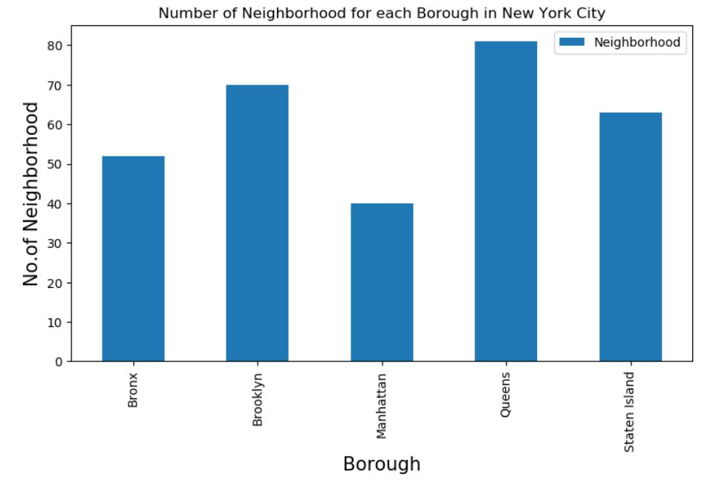
No. of neighbourhood for each borough in NYC

Slide 6
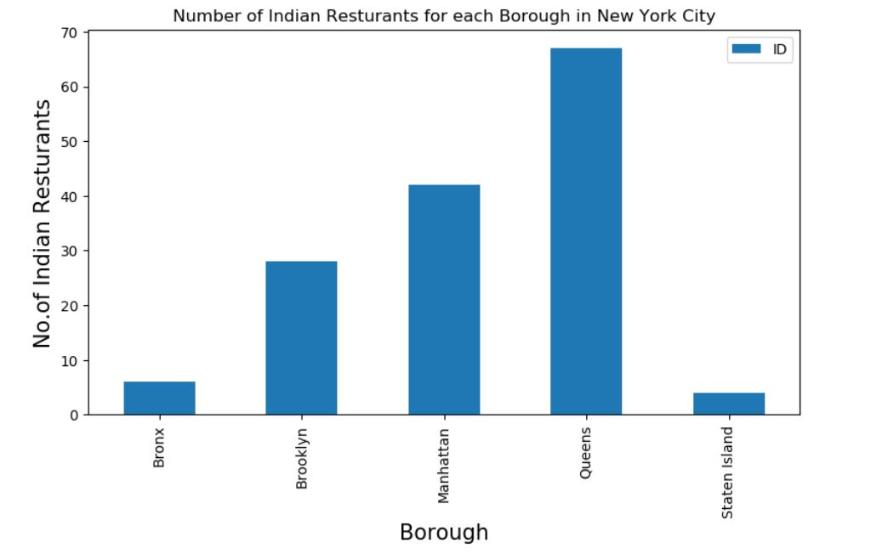
No. of Indian Restaurants for each borough in NYC

Slide 7
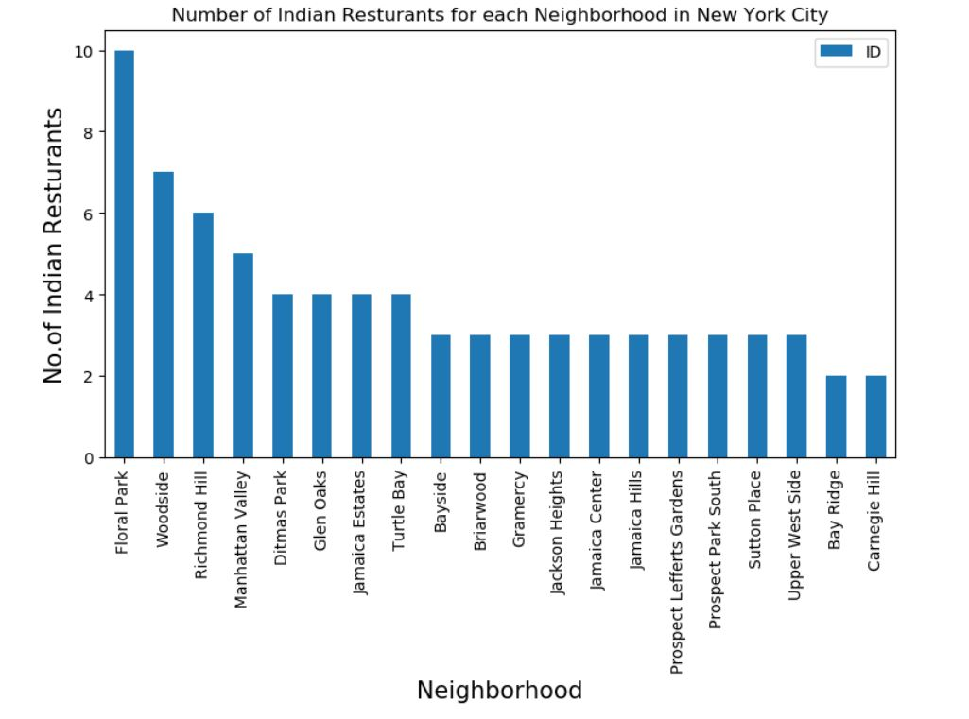
No. of Indian Restaurants for each Neighbourhood in NYC

Slide 8
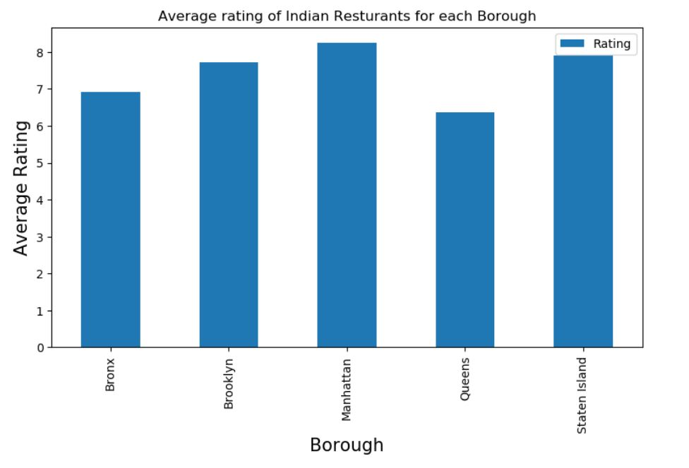
Avg. rating of Indian restaurants each borough

Slide 9
Thank You!

